Slide 1

Geun woo
Time Minder

Slide 2
Program Introduction
01
02
03
04
05
06
07
08
Feature Description
GUI Configuration
Tray Icon Features
Table of content
Using System Resources
Program Flowchart
Example of code execution
Key Code Desciption

Slide 3
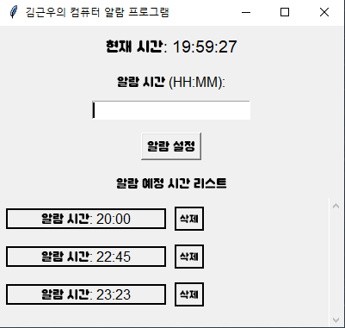
01 Program Introduction
Goal
The program provides an alarm function on your computer, allowing users to set alarms and stop alarm sounds at certain times.
Execution screen
Reason for development
I developed a computer alarm program because many people often miss alarms when they do not use their cell phones well when working or playing games on their computers. In particular, it is often difficult to hear cell phone alarms properly in noisy environments such as headsets, earphones, and speakers. To solve this problem, we developed an alarm program using Python so that you can set and hear alarms even when working on your computer. The program provides a function to make alarm sound by executing alarm.mp3, an alarm file, according to the alarm time (HH:MM) that you specify. This helps users not to miss important alarms while using their computers.
Key Features
1. Set alarm time 2. Managing Alarm Lists (Add, Delete Alarms) 3. Play alarm sounds and close alarms 4. Running and managing background through system tray icons 5. Minimize windows to control programs with tray icons

Slide 4
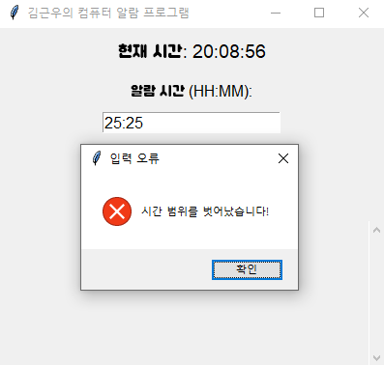
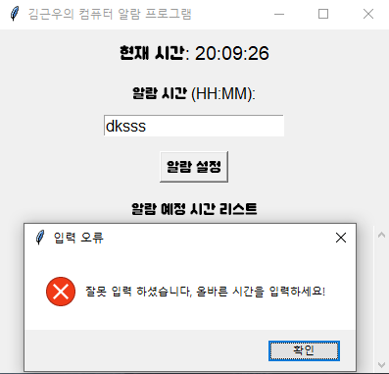
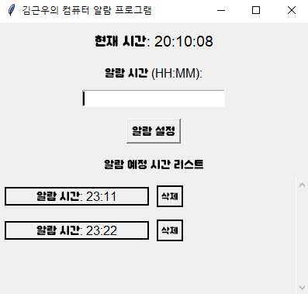
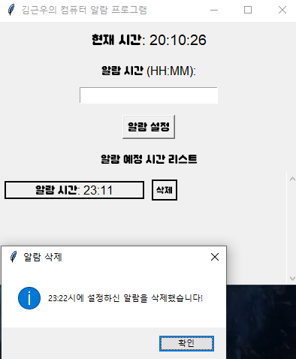
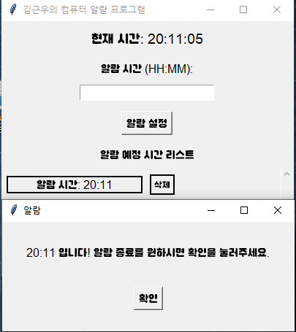
02 Feature Description
Execution screen
Alarm settings and validation
- Enter alarm time: The user enters the alarm time in HH:MM format. - Input Validation 1. Display an error message if the time is in the wrong format 2. Display an error message if the alarm time set is duplicated 3. Inspect to set alarm time within 24-hour time range
Managing Alarm Lists
- Alarm list 1. You can check and delete a list of alarm times that have been set. 2. Users can add or delete alarms at any time..
문제점 분석
Alarm sound playback and alarm termination notification
- the sound of an alarm 1. The alarm sounds repeatedly at the set time 2. If you want to end the alarm, press the end button to stop the alarm sound and delete the alarm..

Slide 5
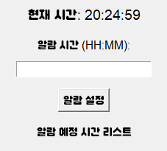
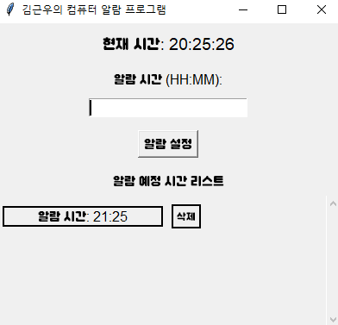
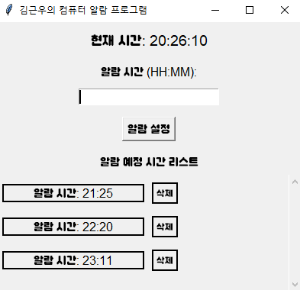
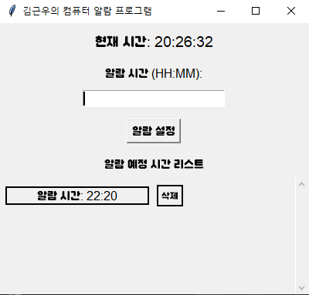

03 GUI Configuration
Execution screen
UI Configuration Using Tkinter
Main Window
1. A Tkinter window is created at the start of the program. T2. he current time, alarm time input field, alarm list, and so on are displayed. 3. The alarm list is updated after the alarm is set.
Alarm Time Input UI
1. The user enters the alarm time in the text field. 2. If you enter the correct time, the alarm will be set.
Alarm List UI
Displays the set alarms in the form of a list, and a delete button is added to each alarm to allow the user to delete the alarm.
문제점 분석
scrollable list
A scrolling feature has been added to the list to allow you to add multiple alarms.

Slide 6
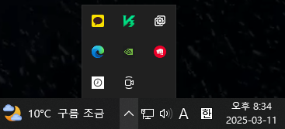
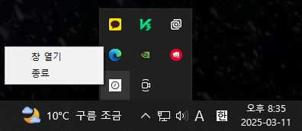
04 Tray Icon Features
Execution screen
Run the program in the background
Tray Icon
1. It can be executed by minimizing it with icons in the system tray without shutting down the program. 2. Click the tray icon to reopen the program window.
Tray Icon Menu
There are two options on the menu. 1. Opening a window: Click the tray icon to open a program window 2. Shutdown: Shut down the program.
문제점 분석

Slide 7
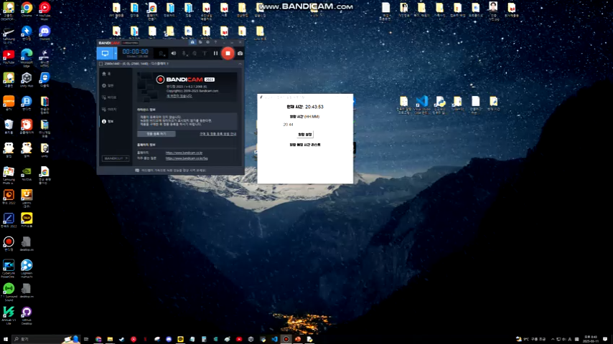
05 Using System Resources
Execution screen
Window Handling Using ctypes
Find window handle 1. Use ctypes.windll.user32.FindWindowW to locate and activate an existing window if the program is already running. 2. When an existing program is running, prevent duplicate runs and reactivate the existing window.
Source Han Sans KR Bold
문제점 분석
Play alarm sound 1. Repeatedly play the alarm sound using pygame.mixer.Sound. 2. At the end of the alarm, call pygame.mixer.Sound.stop() to stop the sound.

Slide 8
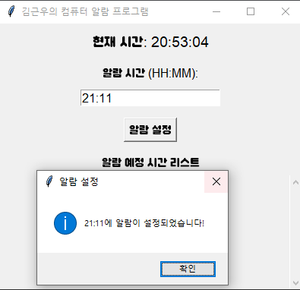
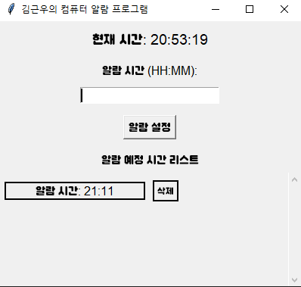

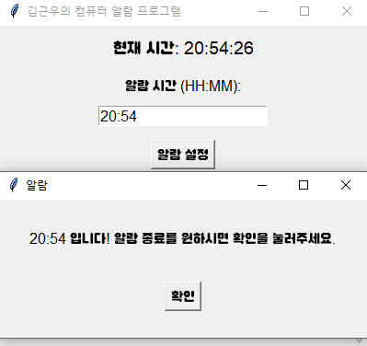
06 Program Flowchart
Execution screen
Start the program
When the program starts, a Tkinter window opens and a system tray icon is also created.
alarm setting
The user enters the alarm time and clicks the Settings button. When the alarm time is valid, it is added to the alarm list and the alarm is set.
Check alarm time
The program checks the current time every second and triggers an alarm when the alarm time is set.
End of alarm
문제점 분석
When the alarm goes off, it provides the user with the end of the alarm button, stopping the alarm and deleting it from the alarm list.
Visualize program flowcharts
In this section, you can use the program flowchart to visually explain how each function is connected.

Slide 9
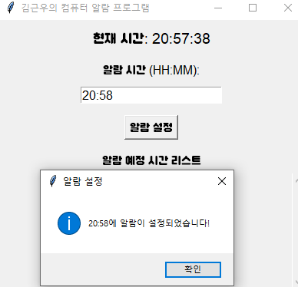

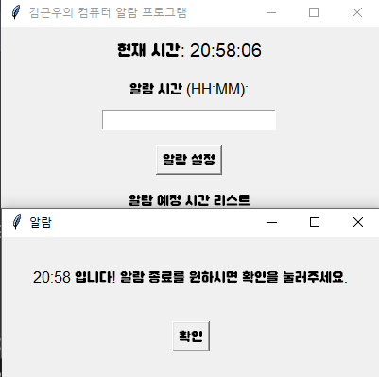
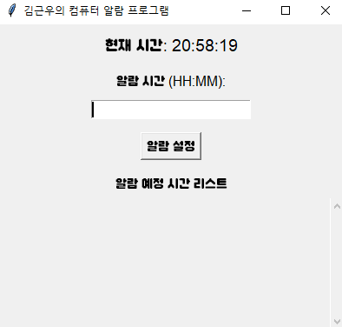
07 Example of code execution
Execution screen
Example of code execution
Example alarm settings
1. The user enters "07:00" and sets the alarm. 2. "07:00" is added to the alarm list, and the alarm starts ringing at 07:00.
Alarm sounds and shut down
The alarm goes off, and the user presses the "OK" button to end the alarm.
문제점 분석

Slide 10
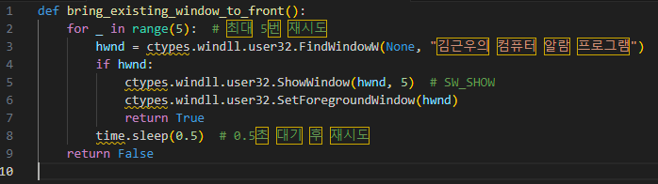
08 Key Code Desciption
Prevent duplicate runs and enable existing windows
Features: The FindWindowW function serves to locate the handle of the currently open window. Use ShowWindow and SetForegroundWindow to activate the window that is already running. Purpose: It is used to prevent duplicate programs from running, and to relaunch a program window that is already running.
문제점 분석

Slide 11
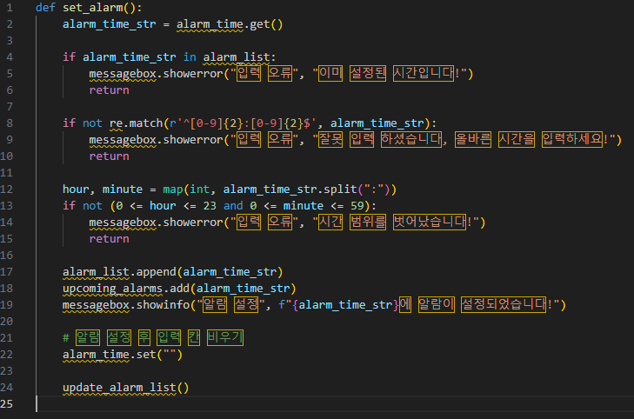
08 Key Code Desciption
Alarm settings and validation
Features: After the user enters the alarm time, various validations are performed. Outputs an error message if the time format is incorrect for HH:MM or if it is already set alarm time. If it is out of the range of 0 <= hour <= 23 and 0 <= minute <= 59, it causes an error.
Purpose: It only sets valid alarm times, and serves to inform the user of invalid inputs.
문제점 분석

Slide 12
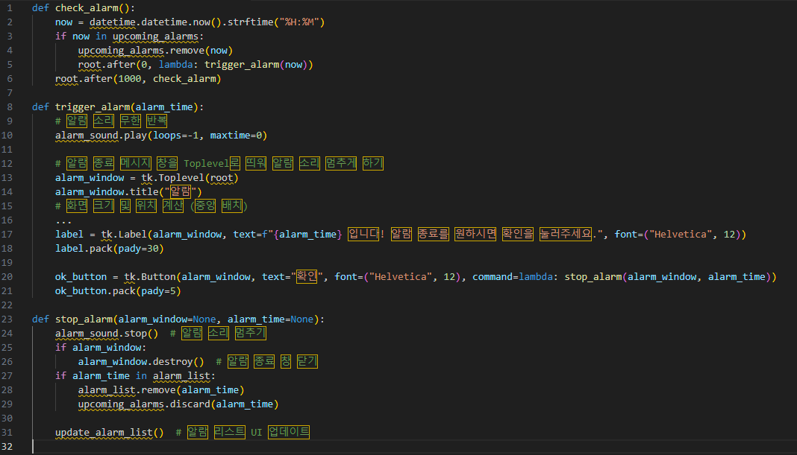
08 Key Code Desciption
Check alarm and play alarm sound
Features: The check_alarm() function checks the current time every second and triggers an alarm when the alarm time is set. The trigger_alarm() function repeatedly plays the alarm sound when the alarm goes off, and a new window, including the end alarm button, provides the user with the option to end the alarm. The stop_alarm() function stops the alarm sound and deletes the alarm from the list. Purpose: It is responsible for sounding the alarm, providing the user with a UI to end the alarm, and removing the alarm from the list after it ends.
문제점 분석

Slide 13
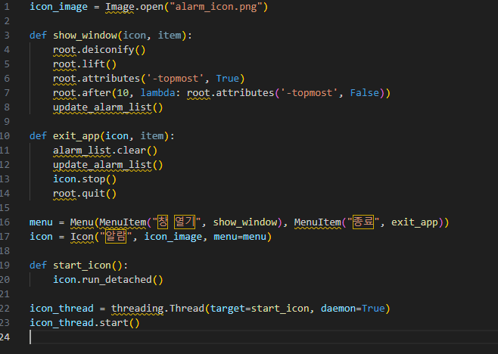
08 Key Code Desciption
Tray Icon Features
Features: Tray icon: Use the pystray library to add icons to the system tray. Click the icon to reopen the window, and it also provides an exit menu. The show_window() function serves to float the program window when the tray icon is clicked. The exit_app() function initializes the alarm list at the end of the program and exits the program. Purpose: Run the program in the background and make it easy to control through the tray icon.
문제점 분석

Slide 14
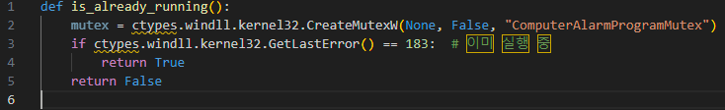
08 Key Code Desciption
Windows handles and prevent redundancy
Features: This function uses CreateMutexW to verify that the program is already running. If it is already running, the GetLastError() value is 183, preventing duplicate runs. Purpose: Ensure that the program does not run in duplicate.
문제점 분석

Slide 15
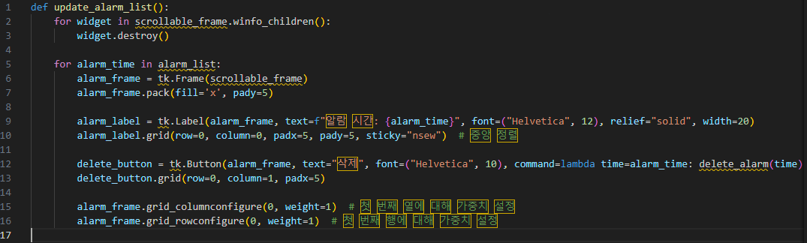
08 Key Code Desciption
Update Alarm list
Features: Display the alarm list dynamically in the UI, and add a delete button for each alarm. Once a user deletes an alarm, remove it from the list and update the UI. Purpose: It is responsible for checking alarms set by users in real time and updating the UI for easy deletion.
문제점 분석

Slide 16
Key Developer of the Future
Geun Woo Kim
T
010-2113-1655
E
rmsdn1955@gmail.com
E
rmsdn1955@naver.com

